Slide 1

Microsoft Power BI

Slide 2
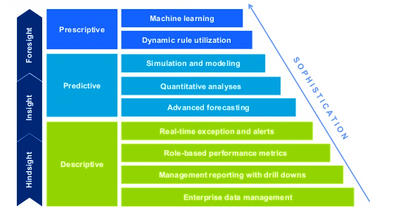
Source: Deloitte

Slide 3
Tables and more
Combining two features we use in isolation to our benefit
Known feature becomes unknown in a new setting – Zoom out and Drag, Control + A to select a table.
Spreadsheet is not a table, neither is adding formatting
Insert Table :
Help Excel know where to end.
Filters, Colour Formatting & More. Is a bonus
Rules: Data is columnar, each column has a header, no merges, no formulas in the header. Essentially Tabular data.
What is Good data ? Anything that can directly be converted to a table
Maintaining raw data as a report – issues? Never do it,
Data in headers is a show spoiler
Data in Header and Row start cell is worse – cross tab data
Its natural but counter productive to maintain if other reports are needed

Slide 4
Fill me up – Auto Fill and Flash Fill (Latest!)
Very useful feature of 2013
Auto fill options and shortcut
Ctrl shift down + Ctrl D
Flash fill (only in 2013) -
Multiple uses
Intelligent learning fill functions
Based on a Ph.D. research

Slide 5
Almost every action we perform using Excel is . . .
I N E F F I C I E N T
Notes:
Does this sound like a problem?
Firstly you don’t agree with me, but is this the problem yet . .
Notice it – this is the first step to the problem
Acknowledge it – Of you are stuck
Ans: Problem is that we do not even know it.
LET ME PROVE IT, LET ME LAUNCH INTO INTO MY FIRST EXAMPLE. . .

Slide 6
How to copy a formula
Drag
Double click
Copy paste
Notes:
- Every one knows these are bad, its all personal preference.
Personal preference vs. Standardisation
Companies spend time optimising, websites, apps, factory shop floors – no – one optimises or even standardises spreadsheets
50% of life goes in Office which is never even looked at from optimisation

Slide 7
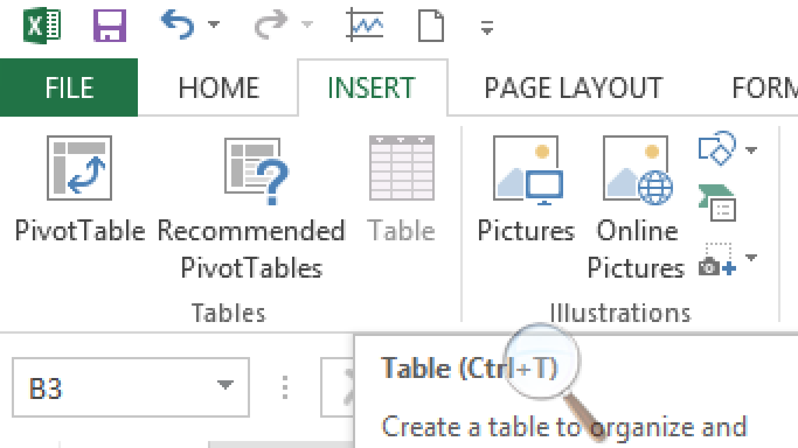
How to copy a formula
Drag
Double click
Copy paste
Insert → Table
Notes:
ALL THREE ARE BAD
INSERT TABLE : Tell excel where is the end point . And then it will do it on your own.
Everyone is surprised but no one is happy – as you are calculating how much time you have wasted in your life.
2007 – 8 years wasted, were you born to copy formulas??

Slide 8
Compliance
Error checking – a must before you work on any excel sheet
What is my Data set is full of errors and it will take hours to correct
Tabular data is good data
No formulas in headers
No merged cells
One data per cell
No formatting to represent data
Notes:
Spreadsheets depend on you to remember formulas and update them. . No risk for Microsoft there. . .
WE IGNORE THE GREEN MARK…
IT IS NOT DESIGNED FOR IGNORING
WE NEVER CLICK THERE

Slide 9

http://www.eusprig.org/horror-stories.htm
What is spreadsheet risk ?
Notes:
2000 Programmers for 25 years.
Everything you thought is new is old.
You never see the solution because you think YOU ARE THE SOLUTION!
SO – Think the solution is there and that you have to find it

Slide 10
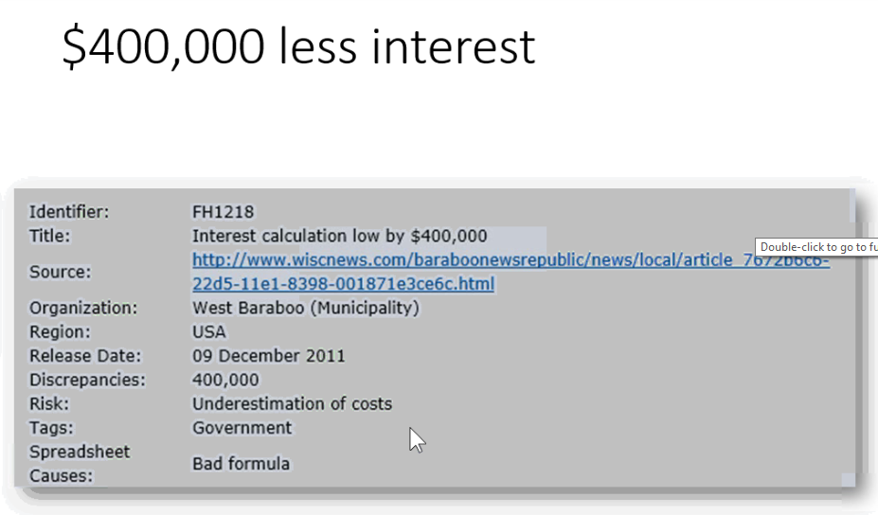
What’s happens when you don’t know Excel
Notes:
In excel there is not ownership , no process, there is only UNDOCUMENTED Chaos

Slide 11
Consolidating multiple ranges
Example of consolidating multiple ranges of data into one range
Alt D + P – Consolidate multiple ranges, very useful feature to consolidate multiple Cross tab data
Clubbing – Months into quarters for example
We’re set now , saved a lot of time, so now what ?
Clear backlog of work
Do new and cool stuff by building relationship with client
Ask the question “What is this report used for ? Who all access this report? Would it help if I gave you another interesting view ? I want to know how I can help you . . .

Slide 12
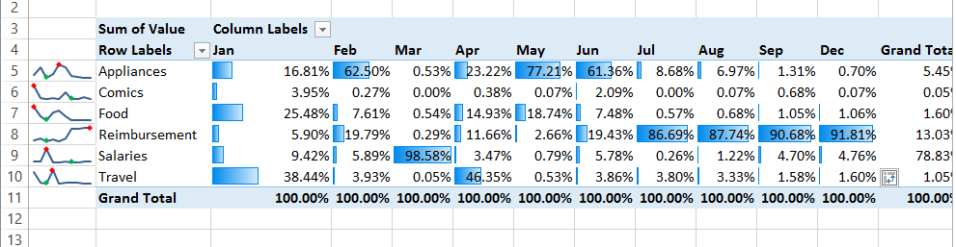
Want to do more cool stuff? Data Surface Charting
Improve Interpretation of the data – Embed Visuals on the surface of the data table
Sparkline's :
Since 2010, eliminates need for multiple Y Axis, more meaningful
Different view of the same data in a few clicks to manage cash flow
Conditional Formatting : Data bars, bars within table surface. Easy visual interpretation

Slide 13

Power BI evolved from Excel Add - Ins

Slide 14



Slide 15
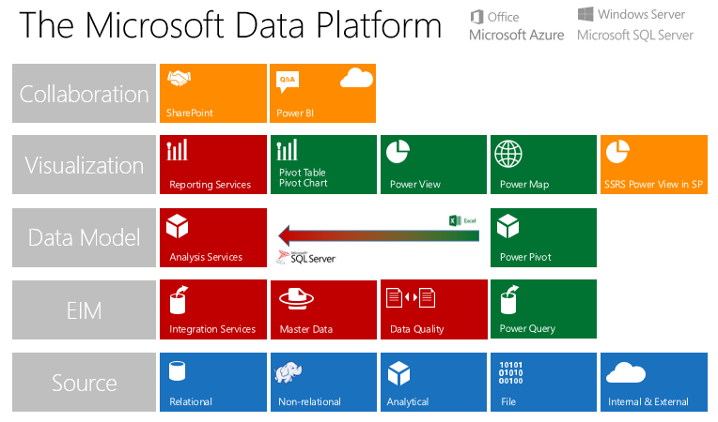
Microsoft Business Intelligence tools in Excel

Slide 16
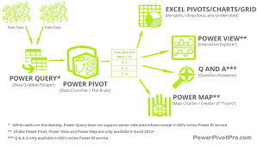
Power BI Suite - Thematic

Slide 17
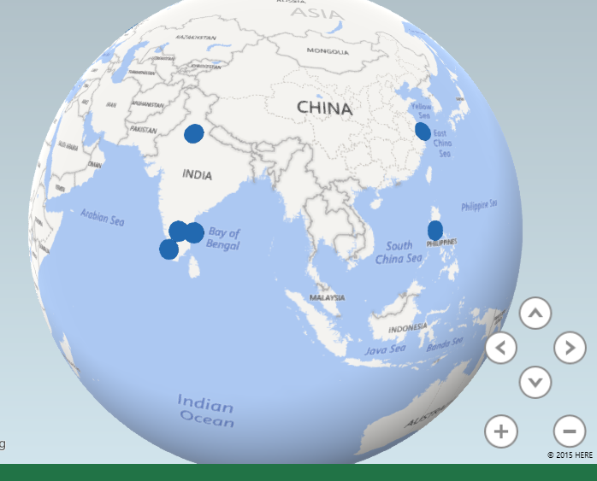
Trainings locations and participants
Location | Participants
Bangalore | 150
Delhi | 80
Cochin | 12
Chennai | 10
Shanghai | 5
Manila | 6
Sydney | 2
New York | 15
Seattle | 20
Dallas | 15
London | 12
Warsaw | 3

Slide 18
Tabular vs. Geographical View?
Tabular only
Geographical only
Both Tabular + Geographical
Why?

Slide 19
Power Map
Power Map is a part of the “Power BI Suite” added into Excel
Power map has the ability to call on Bing location services to convert political names like Delhi and Hartford and convert it into Geospatial data of latitude and longitude

Slide 20
Power Maps (contd.)
With Power Map, you can plot geographic and temporal data on a 3-D globe or custom map, show it over time, and create visual tours you can share with other people. You’ll want to use Power Map to
Plot more than a million rows of data visually on Bing maps in 3-D format from an Excel table or Data Model in Excel.
Discover insights Gain new understandings by viewing your data in geographic space and seeing time-stamped data change over time.
Share stories Capture screenshots and build cinematic, guided video tours you can share broadly, engaging audiences like never before. Or export tours to video and share them that way as well.

Slide 21
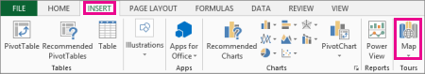
Where do I find it?
Power MAP download
http://www.microsoft.com/en-in/download/details.aspx?id=38395

Slide 22
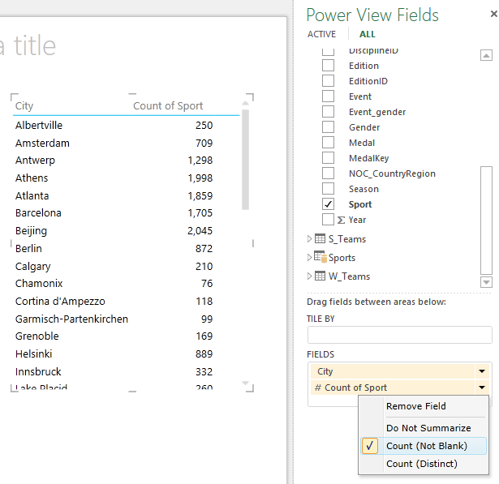
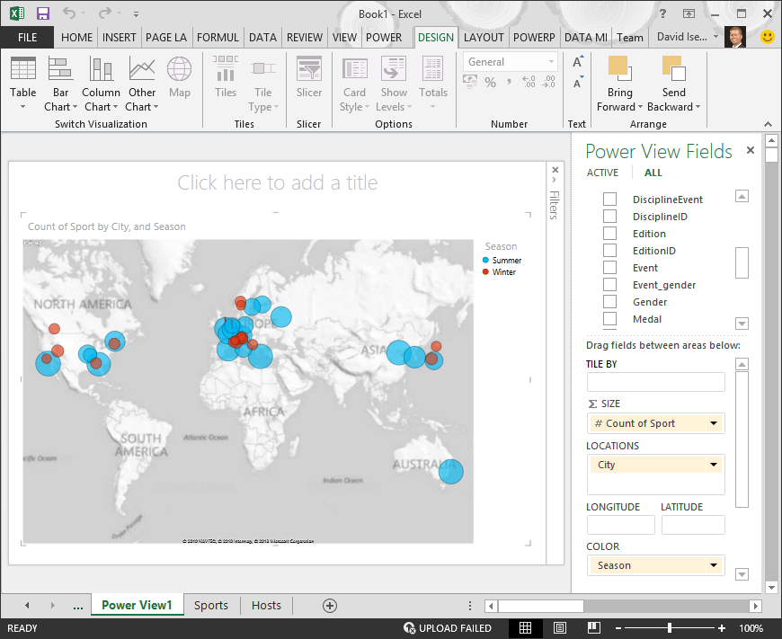
Vs
https://support.office.com/en-za/article/Tutorial-Create-Map-based-Power-View-Reports-62ecd29a-91b8-4e5c-b3b7-4aef9f7ef962?ui=en-US&rs=en-ZA&ad=ZA

Slide 23
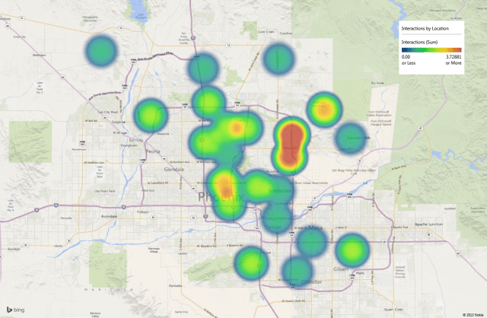
ZIPCODE HEAT MAP

Slide 24

Tour 2

Slide 25
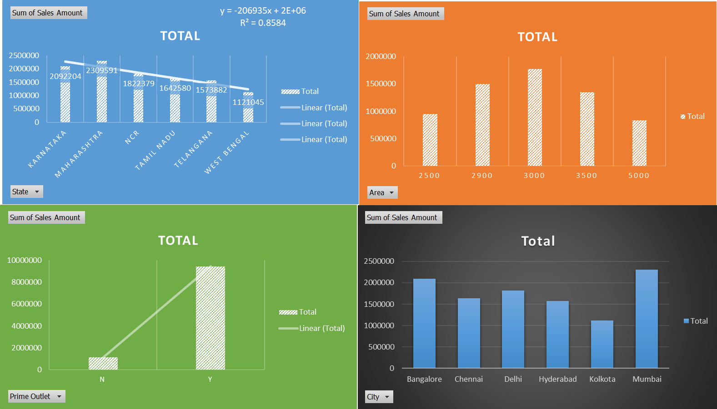

Slide 26
Power MAP download
http://www.microsoft.com/en-in/download/details.aspx?id=38395
Power PIVOT download
https://msdn.microsoft.com/en-us/library/gg413462(v=sql.110).aspx
Power VIEW download
http://www.microsoft.com/en-in/download/details.aspx?id=13

Slide 27


